Slide 1
Alexis Perez
Goals for the week
  OpenCV Learning and Testing
  Test vehicle components together
Progress for the week
  OpenCV testing on Webcam
  Ordered Chassis to test components
Goals for next week
  Implement OpenCV with RaspberryPi Camera
Hours spent on progress
  6 hours.

Slide 2
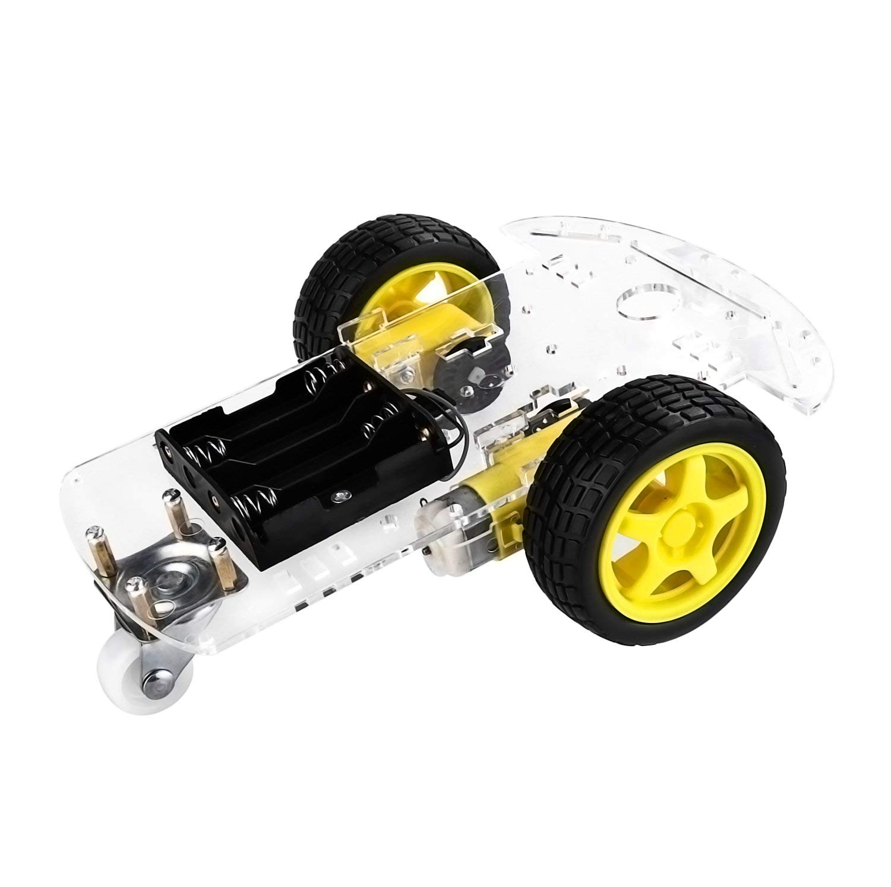
Test Chassis

